Slide 1
Stastistical Machine Learning for Data Science
Course Code BAD702
Module -1
Exploratory Data Analysis
By Sunil Naidu G R

Slide 2
Exploratory Data Analysis (EDA) is the process of investigating a dataset to understand its main characteristics, discover patterns, detect anomalies, test hypotheses, and check assumptions — all before applying formal modeling or machine learning techniques. It’s like taking your dataset out for coffee to see what it’s really like before you commit to building a full-blown predictive model.
Why is EDA important?
Understand the data structure – size, types of variables, missing values.
Detect outliers or anomalies – spot data points that don’t fit expectations.
Validate assumptions – check if data meets conditions required for statistical models.
Guide feature engineering – identify what transformations or new variables might help.
Prevent costly mistakes – ensures you don’t feed bad data into your model.

Slide 3
Key Terms for Data Types
Numeric
Data that are expressed on a numeric scale.
Continuous
Data that can take on any value in an interval. (Synonyms: interval, float,numeric)
Discrete
Data that can take on only integer values, such as counts. (Synonyms: integer,count)
Categorical
Data that can take on only a specific set of values representing a set of possible categories. (Synonyms: enums, enumerated, factors, nominal)
Binary
A special case of categorical data with just two categories of values, e.g., 0/1, true/false. (Synonyms: dichotomous, logical, indicator, boolean)
Ordinal
Categorical data that has an explicit ordering. (Synonym: ordered factor)

Slide 4
Data frame
Rectangular data (like a spreadsheet) is the basic data structure for statistical and machine learning models.
Feature
A column within a table is commonly referred to as a feature.
Synonyms
attribute, input, predictor, variable
Outcome
Many data science projects involve predicting an outcome—often a yes/no outcome
(in Table 1-1, it is “auction was competitive or not”). The features are sometimes used to predict the outcome in an experiment or a study.
Synonyms
dependent variable, response, target, output
Records
A row within a table is commonly referred to as a record.
Synonyms
case, example, instance, observation, pattern, sample

Slide 5
Table 1-1. A typical data frame format
Category | currency | Seller Rating | Duration | End Day | Close Price | Open Price | Competitive?
Music/Movie/Game | US | 3249 | 5 | Mon | 0.01 | 0.01 | 0
Music/Movie/Game | US | 3249 | 5 | Mon | 0.01 | 0.01 | 0
Automotive | US | 3115 | 7 | Tue | 0.01 | 0.01 | 0
Automotive | US | 3115 | 7 | Tue | 0.01 | 0.01 | 0
Automotive | US | 3115 | 7 | Tue | 0.01 | 0.01 | 0
Automotive | US | 3115 | 7 | Tue | 0.01 | 0.01 | 0
Automotive | US | 3115 | 7 | Tue | 0.01 | 0.01 | 1
Automotive | US | 3115 | 7 | Tue | 0.01 | 0.01 | 1

Slide 6
Key Terms for Estimates of Location
Mean
The sum of all values divided by the number of values.
Synonym
Average
Weighted mean
The sum of all values times a weight divided by the sum of the weights.
Synonym
weighted average
Median
The value such that one-half of the data lies above and below.
Synonym
50th percentile
Estimates of Location
Variables with measured or count data might have thousands of distinct values. A basic step in exploring your data is getting a “typical value” for each feature (variable): an estimate of where most of the data is located (i.e., its central tendency).

Slide 7
Percentile
The value such that P percent of the data lies below.
Synonym
Quantile
Weighted median
The value such that one-half of the sum of the weights lies above and below the
sorted data.
Trimmed mean
The average of all values after dropping a fixed number of extreme values.
Synonym
truncated mean
Robust
Not sensitive to extreme values.
Synonym
resistant
Outlier
A data value that is very different from most of the data.
Synonym
extreme value

Slide 8
State | Population | Murder rate | Abbreviation
1Alabama | 4,779,736 | 5.7 | AL
2Alaska | 710,231 | 5.6 | AK
3Arizona | 6,392,017 | 4.7 | AZ
4Arkansas | 2,915,918 | 5.6 | AR
5California | 37,253,956 | 4.4 | CA
6Colorado | 5,029,196 | 2.8 | CO
7Connecticut | 3,574,097 | 2.4 | CT
8Delaware | 897,934 | 5.8 | DE
Tocompute mean and median in Python we can use the pandasmethods of the data frame.
The trimmed mean requires the trim_meanfunction in scipy.stats:
state = pd.read_csv('state.csv')
state['Population'].mean()
trim_mean(state['Population'],0.1)
state['Population'].median()
WeightedmeanisavailablewithNumPy.Forweightedmedian,wecanusethespecial‐ ized package wquantiles:
np.average(state['Murder.Rate'], weights=state['Population'])
wquantiles.median(state['Murder.Rate'],weights=state['Population'])

Slide 9
Metrics and Estimates
Statisticians often use the term estimate for a value calculated from the data at hand, to draw a distinction between what we see from the data and the theoretical true or exact state of affairs. Data scientists and business analysts are more likely to refer to such a value as a metric. The difference reflects the approach of statistics versus that of data science: accounting for uncertainty lies at the heart of the discipline of statistics, whereas concrete business or organizational objectives are the focus of data science. Hence, statisticians estimate, and data scientists measure.
Mean
The most basic estimate of location is the mean, or average value. The mean is the sum of all values divided by the number of values. Consider the following set of numbers:
{3 5 1 2}. The mean is (3 + 5 + 1 + 2) / 4 = 11 / 4 = 2.75. You will encounter the
symbol x (pronounced “x-bar”) being used to represent the mean of a sample from a
population. The formula to compute the mean for a set of n values x1, x2, ..., xn is:
Mean = Σ x /n

Slide 10
Trimmed mean
A variation of the mean is a trimmed mean, which you calculate by dropping a fixed number of sorted values at each end and then taking an average of the remaining values.
Representing the sorted values by x 1 , x 2 , ..., x n where x 1 is the smallest value and x n the largest, the formula to compute the trimmed mean with p smallest and largest values omitted
weighted mean
There are two main motivations for using a weighted mean:
• Some values are intrinsically more variable than others, and highly variable
observations are given a lower weight. For example, if we are taking the average from multiple sensors and one of the sensors is less accurate, then we might down weight the data from that sensor.
• The data collected does not equally represent the different groups that we are interested in measuring. For example, because of the way an online experiment was conducted, we may not have a set of data that accurately reflects all groups in the user base. To correct that, we can give a higher weight to the values from the groups that were underrepresented.

Slide 11
Median and Robust Estimates
The median is the middle number on a sorted list of the data. If there is an even number
of data values, the middle value is one that is not actually in the data set, but rather the average of the two values that divide the sorted data into upper and lower halves. Compared to the mean, which uses all observations, the median depends only on the values in the center of the sorted data.
Outliers
The median is referred to as a robust estimate of location since it is not influenced by outliers (extreme cases) that could skew the results. An outlier is any value that is very distant from the other values in a data set.
Anomaly Detection
In contrast to typical data analysis, where outliers are sometimes informative and sometimes a nuisance, in anomaly detection the points of interest are the outliers, and the greater mass of data serves primarily to define the “normal” against which anomalies are measured.

Slide 12
The median is not the only robust estimate of location. In fact, a trimmed mean is widely used to avoid the influence of outliers. For example, trimming the bottom and top 10% (a common choice) of the data will provide protection against outliers in all but the smallest data sets. The trimmed mean can be thought of as a compromise between the median and the mean: it is robust to extreme values in the data, but uses more data to calculate the estimate for location.
Estimates of Variability
Location is just one dimension in summarizing a feature. A second dimension, variability, also referred to as dispersion, measures whether the data values are tightly clustered or spread out. At the heart of statistics lies variability: measuring it, reducing it, distinguishing random from real variability, identifying the various sources of real variability, and making decisions in the presence of it.
Deviations
The difference between the observed values and the estimate of location.
Synonyms
errors, residuals

Slide 13
Variance
The sum of squared deviations from the mean divided by n – 1 where n is the
number of data values.
Synonym
mean-squared-error
Standard deviation
The square root of the variance.
Mean absolute deviation
The mean of the absolute values of the deviations from the mean.
Synonyms
l1-norm, Manhattan norm
Median absolute deviation from the median
The median of the absolute values of the deviations from the median.
Range
The difference between the largest and the smallest value in a data set.

Slide 14
Order statistics
Metrics based on the data values sorted from smallest to biggest.
Synonym
ranks
Percentile
The value such that P percent of the values take on this value or less and (100–P)
percent take on this value or more.
Synonym
Quantile
Interquartile range
The difference between the 75th percentile and the 25th percentile.
Synonym
IQR
The pandas data frame provides methods for calculating standard deviation and quantiles. Using the quantiles, we can easily determine the IQR. For the robust MAD,
we use the function robust.scale.mad from the statsmodels package:
state['Population'].std()
state['Population'].quantile(0.75)-state['Population'].quantile(0.25) robust.scale.mad(state['Population'])

Slide 15
Exploring the Data Distribution
Each of the estimates we’ve covered sums up the data in a single number to describe the location or variability of the data. It is also useful to explore how the data is distributed overall. Key Terms for Exploring the Distribution
Boxplot
Summarizes the data using quartiles:
Q1 (25th percentile)
Median (50th percentile)
Q3 (75th percentile)
Whiskers show minimum and maximum (or near-min/max), and any outliers.
Frequency table
Shows how many observations fall in each class interval.
Histogram
A bar graph showing the same frequencies visually. Taller bars = higher frequencies. It’s essentially the graphical form of your frequency table.
Density plot
A smoothed version of the histogram, often based on a kernel density estimate. instead of bars, it shows a continuous curve

Slide 16
Exploring Binary and Categorical Data
For categorical data, simple proportions or percentages tell the story of the data.
Mode
The most commonly occurring category or value in a data set.
Expected value
When the categories can be associated with a numeric value, this gives an average value based on a category’s probability of occurrence.
Bar charts
The frequency or proportion for each category plotted as bars.
Pie charts
The frequency or proportion for each category plotted as wedges in a pie.

Slide 17
Percentiles and Boxplots
we explored how percentiles can be used to measure the spread of the data. Percentiles are also valuable for summarizing the entire distribution. It is common to report the quartiles (25th, 50th, and 75th percentiles) and the deciles (the 10th, 20th, …, 90th percentiles). Percentiles are especially valuable for summarizing the tails (the outer range) of the distribution. Popular culture has coined the term one-percenters to refer to the people in the top 99th percentile of wealth.
Table 1-4 displays some percentiles of the murder rate by state. In R, this would be produced by the quantile function:
quantile(state[['Murder.Rate']], p=c(.05, .25, .5, .75, .95))
5% 25% 50% 75% 95%
1.600 2.425 4.000 5.550 6.510
The pandas data frame method quantile provides it in Python:
state['Murder.Rate'].quantile([0.05, 0.25, 0.5, 0.75, 0.95])
Table 1-4. Percentiles of murder rate by state
5% 25% 50% 75% 95%
1.60 2.42 4.00 5.55 6.51
The median is 4 murders per 100,000 people, although there is quite a bit of variability:
the 5th percentile is only 1.6 and the 95th percentile is 6.51.
Boxplots, introduced by Tukey [Tukey-1977], are based on percentiles and give a
quick way to visualize the distribution of data

Slide 18
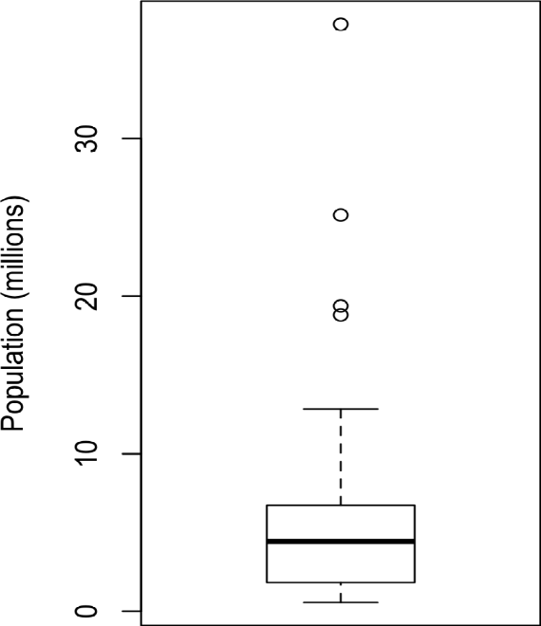
shows a boxplot of the population by state produced by python:
pandas provides a number of basic exploratory plots for data frame; one of them is
boxplots:
ax = (state['Population']/1_000_000).plot.box()
ax.set_ylabel('Population (millions)’)
From this boxplot we can immediately see that the median state population is about 5 million, half the states fall between about 2 million and about 7 million, and there are some high population outliers. The top and bottom of the box are the 75th and 25th percentiles, respectively. The median is shown by the horizontal line in the box. The dashed lines, referred to as whiskers, extend from the top and bottom of the box to indicate the range for the bulk of the data.
Any data outside of the whiskers is plotted as single points or circles (often considered outliers).

Slide 19
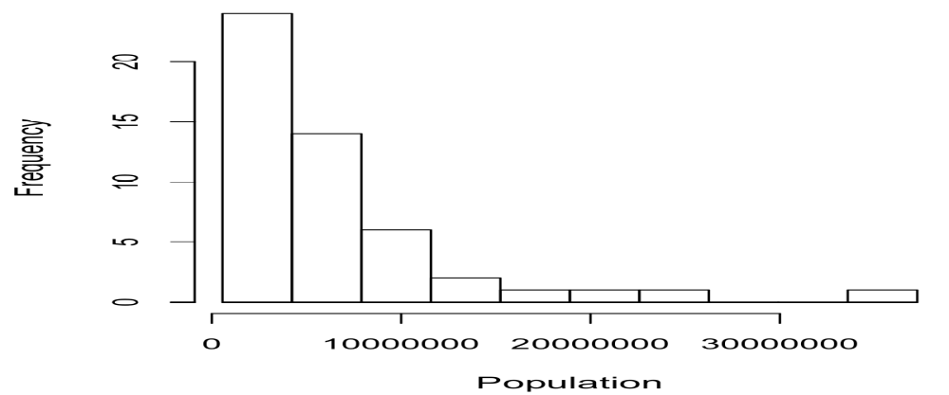
Frequency Tables and Histograms •
Empty bins are included in the graph.
• Bins are of equal width.
• The number of bins (or, equivalently, bin size) is up to the user.
• Bars are contiguous—no empty space shows between bars, unless there is an
empty bin.
The function pandas.cut creates a series that maps the values into the segments.
Using the method value_counts, we get the frequency table:
binnedPopulation = pd.cut(state['Population'], 10)
binnedPopulation.value_counts()
Figure 1-3. Histogram of state populations

Slide 20
Table 1-5. A frequency table of population by state
BinNumber BinRange Count States
1. 563,626–4,232,658 24 WY, VT, ND, AK, SD, DE, MT, RI, NH, ME, HI, ID, NE, WV, NM, NV, UT, KS, AR, MS, IA, CT, OK, OR
2. 4,232,659–7,901,691 14
KY, LA, SC, AL, CO, MN, WI, MD, MO, TN, AZ, IN, MA, WA
3. 7,901,692–11,570,724 6 VA, NJ, NC, GA, MI, OH
4. 11,570,725–15,239,757 2 PA, IL
5. 15,239,758–18,908,790 1 FL
6. 18,908,791–22,577,823 1 NY
7. 22,577,824–26,246,856 1 TX
8. 26,246,857–29,915,889 0
9. 29,915,890–33,584,922 0
10. 33,584,923–37,253,956 1 CA

Slide 21
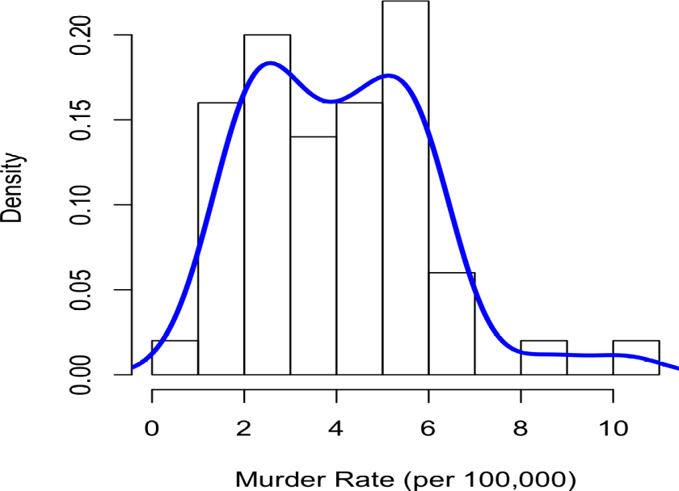
Density Plots and Estimates
Related to the histogram is a density plot, which shows the distribution of data values as a continuous line. A density plot can be thought of as a smoothed histogram, although it is typically computed directly from the data through a kernel density estimate.
pandas provides the density method to create a density plot. Use the argument bw_method to control the smoothness of the density curve:
ax = state['Murder.Rate'].plot.hist(density=True, xlim=[0,12], bins=range(1,12))
state['Murder.Rate'].plot.density(ax=ax)
ax.set_xlabel('Murder Rate (per 100,000)')
Figure 1-4. Density of state murder rates

Slide 22
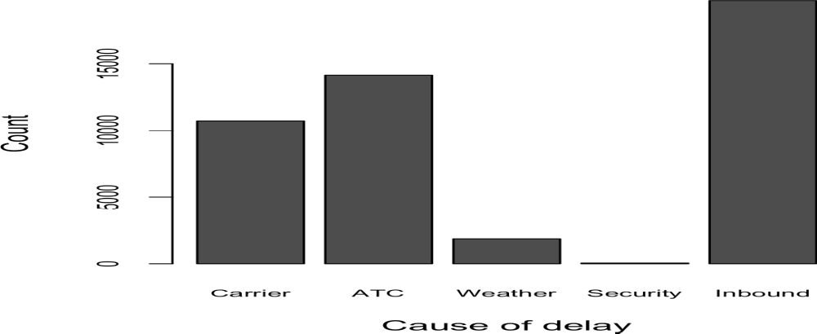
Getting a summary of a binary variable or a categorical variable with a few categories is a fairly easy matter: we just figure out the proportion of 1s, or the proportions of the important categories. For example, Table 1-6 shows the percentage of delayed flights by the cause of delay at Dallas/Fort Worth Airport since 2010. Delays are categorized as being due to factors under carrier control, air traffic control (ATC) system delays, weather, security, or a late inbound aircraft.
Table. Percentage of delays by cause at Dallas/Fort Worth Airport
Carrier ATC Weather Security Inbound
23.02 30.40 4.03 0.12 42.43
Figure 1-5. Bar chart of airline delays at DFW by cause

Slide 23
Bar charts, seen often in the popular press, are a common visual tool for displaying a single categorical variable. Categories are listed on the x-axis, and frequencies or proportions on the y-axis. Figure 1-5 shows the airport delays per year by cause for Dallas/Fort Worth (DFW), and it is barplot:
pandas also supports bar charts for data frames:
ax = dfw.transpose().plot.bar(figsize=(4, 4), legend=False)
ax.set_xlabel('Cause of delay')
ax.set_ylabel('Count‘)
Mode
The mode is the value—or values in case of a tie—that appears most often in the data.
For example, the mode of the cause of delay at Dallas/Fort Worth airport is “Inbound.” As another example, in most parts of the United States, the mode for religious preference would be Christian. The mode is a simple summary statistic for
categorical data, and it is generally not used for numeric data.
Expected Value
A special type of categorical data is data in which the categories represent or can be
mapped to discrete values on the same scale.

Slide 24
Expected Value
A special type of categorical data is data in which the categories represent or can be mapped to discrete values on the same scale. A marketer for a new cloud technology, for example, offers two levels of service, one priced at $300/month and another at $50/month. The marketer offers free webinars to generate leads, and the firm figures that 5% of the attendees will sign up for the $300 service, 15% will sign up for the $50 service, and 80% will not sign up for anything. This data can be summed up, for financial purposes, in a single “expected value,” which is a form of weighted mean, in which the weights are probabilities.
The expected value is calculated as follows:
1. Multiply each outcome by its probability of occurrence.
2. Sum these values.
In the cloud service example, the expected value of a webinar attendee is thus $22.50
per month, calculated as follows:
EV = 0 . 05 (300) + 0 . 15 (50) + 0 . 80 (0)= 22 . 5

Slide 25
Correlation
Exploratory data analysis in many modeling projects (whether in data science or in research) involves examining correlation among predictors, and between predictors and a target variable. Variables X and Y (each with measured data) are said to be positively correlated if high values of X go with high values of Y, and low values of X go with low values of Y. If high values of X go with low values of Y, and vice versa, the variables are negatively correlated.
Correlation coefficient
A metric that measures the extent to which numeric variables are associated with one another (ranges from –1 to +1).
Correlation matrix
A table where the variables are shown on both rows and columns, and the cell values are the correlations between the variables.
Scatterplot
A plot in which the x-axis is the value of one variable, and the y-axis the value of
another.
Consider these two variables, perfectly correlated in the sense that each goes from low
to high:
v1: {1, 2, 3}
v2: {4, 5, 6}
The vector sum of products is 1 ・ 4 + 2 ・ 5 + 3 ・ 6 = 32.

Slide 26
Table 1-7. Correlation between telecommunication stock returns
T CTL FTR VZ LVLT
T 1.000 0.475 0.328 0.678 0.279
CTL 0.475 1.000 0.420 0.417 0.287
FTR 0.328 0.420 1.000 0.287 0.260
VZ 0.678 0.417 0.287 1.000 0.242
LVLT 0.279 0.287 0.260 0.242 1.000
The visualization of correlation matrices using heatmaps. The following code demonstrates this using the seaborn.heat map package. In the accompanying source code repository, we include Python code to generate the more comprehensive visualization:
etfs = sp500_px.loc[sp500_px.index > '2012-07-01',
sp500_sym[sp500_sym['sector'] == 'etf']['symbol']]
sns.heatmap(etfs.corr(), vmin=-1, vmax=1,
cmap=sns.diverging_palette(20, 220, as_cmap=True))

Slide 27
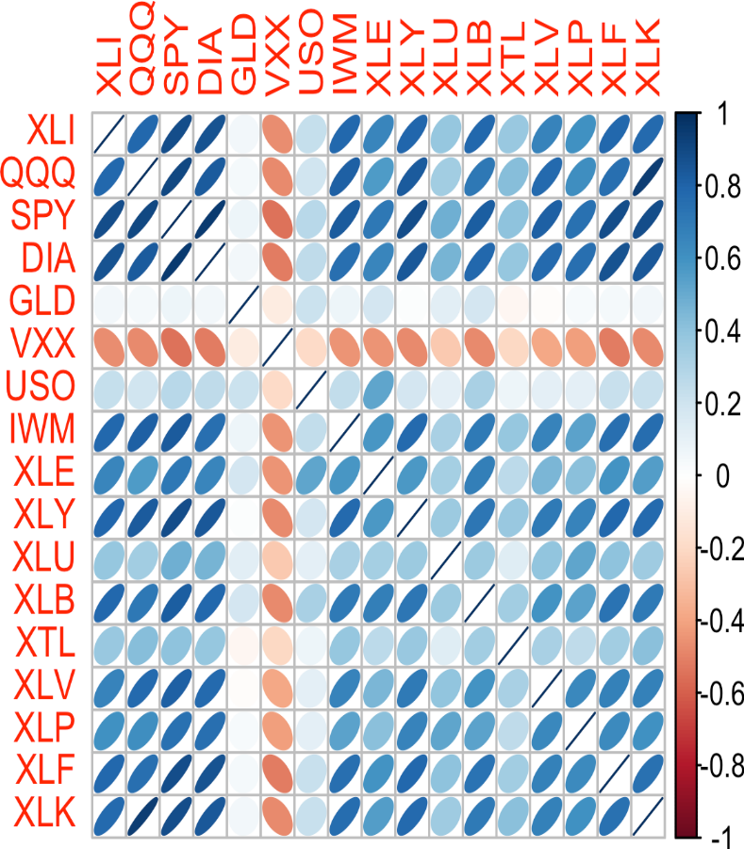
The ETFs for the S&P 500 (SPY) and the Dow Jones Index (DIA) have a high correlation.
Similarly, the QQQ and the XLK, composed mostly of technology companies, are positively correlated. Defensive ETFs, such as those tracking gold prices (GLD), oil prices (USO), or market volatility (VXX), tend to be weakly or negatively correlated with the other ETFs. The orientation of the ellipse indicates whether two variables are positively correlated (ellipse is pointed to the top right) or negatively correlated (ellipse is pointed to the top left). The shading and width of the ellipse indicate the strength of the association: thinner and darker ellipses correspond to stronger relationships.
Figure 1-6. Correlation between ETF returns

Slide 28
Scatterplots
The standard way to visualize the relationship between two measured data variables is
with a scatterplot. The x-axis represents one variable and the y-axis another, and each point on the graph is a record. See Figure 1-7 for a plot of the correlation between the daily returns for ATT and Verizon. This is produced in R with the command:
plot(telecom$T, telecom$VZ, xlab='ATT (T)', ylab='Verizon (VZ)')
The same graph can be generated in Python using the pandas scatter method:
ax = telecom.plot.scatter(x='T', y='VZ', figsize=(4, 4), marker='$\u25EF$')
ax.set_xlabel('ATT (T)')
ax.set_ylabel('Verizon (VZ)')
ax.axhline(0, color='grey', lw=1)
ax.axvline(0, color='grey', lw=1)

Slide 29
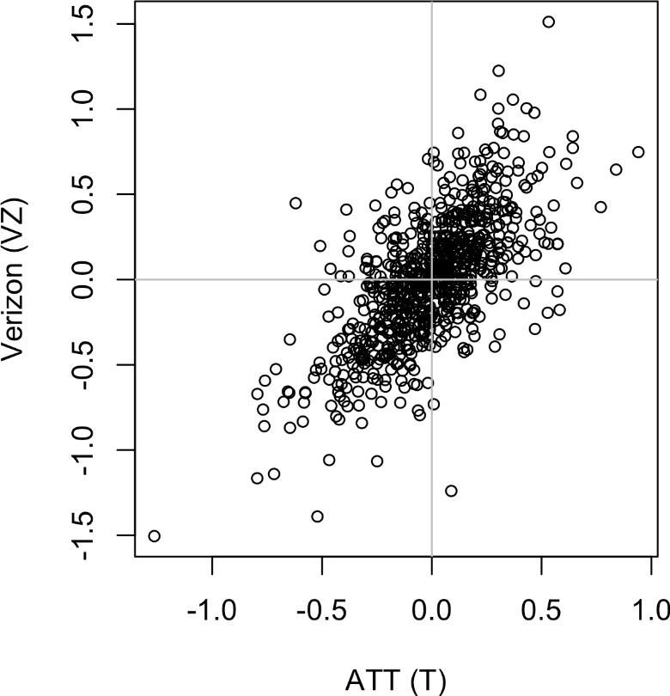
The returns have a positive relationship: while they cluster around zero, on most days, the stocks go up or go down in tandem (upper-right and lower-left quadrants).
There are fewer days where one stock goes down significantly while the other stock goes up, or vice versa (lower-right and upper-left quadrants).
While the plot Figure 1-7 displays only 754 data points, it’s already obvious how difficulit is to identify details in the middle of the plot. We will see later how adding transparency to the points, or using hexagonal binning and density plots, can help to find additional structure in the data.
Figure 1-7. Scatterplot of correlation between returns for ATT and Verizon

Slide 30
Exploring Two or More Variables
Contingency table
A tally of counts between two or more categorical variables.
Hexagonal binning
A plot of two numeric variables with the records binned into hexagons.
Contour plot
A plot showing the density of two numeric variables like a topographical map.
Violin plot
Similar to a boxplot but showing the density estimate.

Slide 31
Scatterplots are fine when there is a relatively small number of data values. The plot
of stock returns in Figure 1-7 involves only about 750 points. For data sets with hundreds of thousands or millions of records, a scatterplot will be too dense, so we need a different way to visualize the relationship. To illustrate, consider the data set kc_tax, which contains the tax-assessed values for residential properties in King County, Washington. In order to focus on the main part of the data, we strip out very expensive and very small or large residences using the subset function:
Figure 1-8 is a hexagonal binning plot of the relationship between the finished square
feet and the tax-assessed value for homes in King County. Rather than plotting points, which would appear as a monolithic dark cloud, we grouped the records into hexagonal bins and plotted the hexagons with a color indicating the number of records in that bin. In this chart, the positive relationship between square feet and tax-assessed value is clear. An interesting feature is the hint of additional bands above the main (darkest) band at the bottom, indicating homes that have the same square footage as those in the main band but a higher tax-assessed value.
In Python, hexagonal binning plots are readily available using the pandas data frame
method hexbin:
ax = kc_tax0.plot.hexbin(x='SqFtTotLiving', y='TaxAssessedValue',
gridsize=30, sharex=False, figsize=(5, 4))
ax.set_xlabel('Finished Square Feet')
ax.set_ylabel('Tax-Assessed Value')

Slide 32
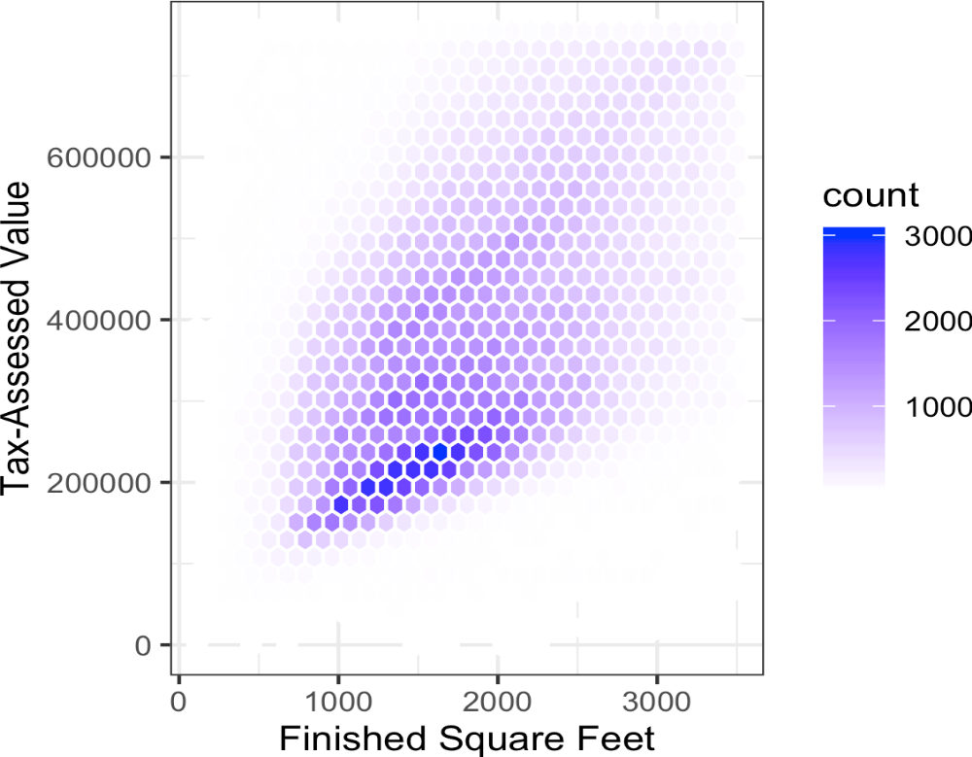
Figure 1-8. Hexagonal binning for tax-assessed value versus finished square feet

Slide 33
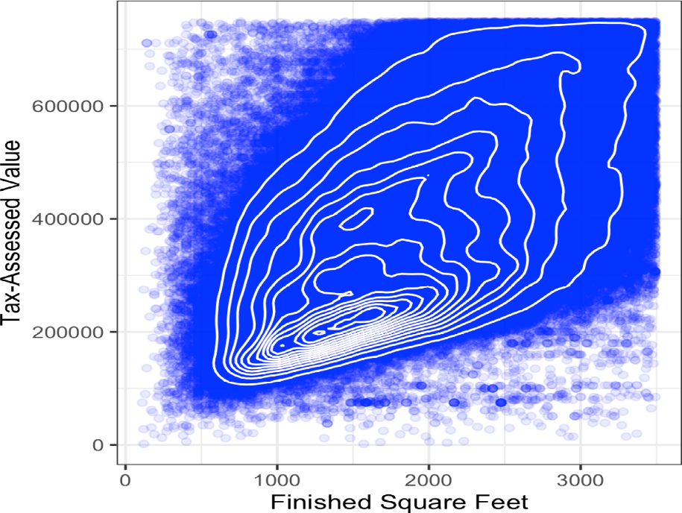
Figure 1-9 uses contours overlaid onto a scatterplot to visualize the relationship
between two numeric variables. The contours are essentially a topographical map to two variables; each contour band represents a specific density of points, increasing as one nears a “peak.” This plot shows a similar story as Figure 1-8: there is a secondary peak “north” of the main peak. This chart was also created using ggplot2 with the built-in geom_density2d function:
Figure 1-9. Contour plot for tax-assessed value versus finished square feet
The seaborn kdeplot function in Python creates a contour plot:
ax = sns.kdeplot(kc_tax0.SqFtTotLiving, kc_tax0.TaxAssessedValue, ax=ax)
ax.set_xlabel('Finished Square Feet')
ax.set_ylabel('Tax-Assessed Value')

Slide 34
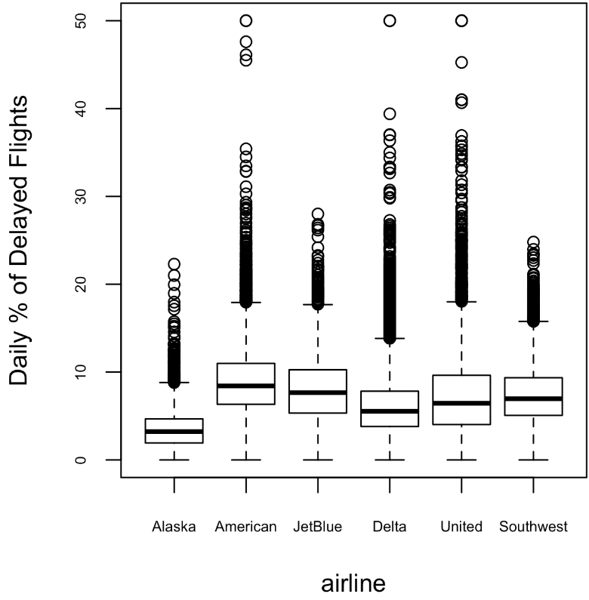
Categorical and Numeric Data
Boxplots are a simple way to visually compare the distributions of a numeric variable grouped according to a categorical variable. For example, we might want to compare how the percentage of flight delays varies across airlines. Figure 1-10 shows the percentage of flights in a month that were delayed where the delay was within the carrier’s control:
Figure 1-10. Boxplot of percent of airline delays by carrier
The pandas boxplot method takes the by argument that splits the data set into groups and creates the individual boxplots:
ax = airline_stats.boxplot(by='airline', column='pct_carrier_delay')
ax.set_xlabel('')
ax.set_ylabel('Daily % of Delayed Flights')
plt.suptitle('')

Slide 35
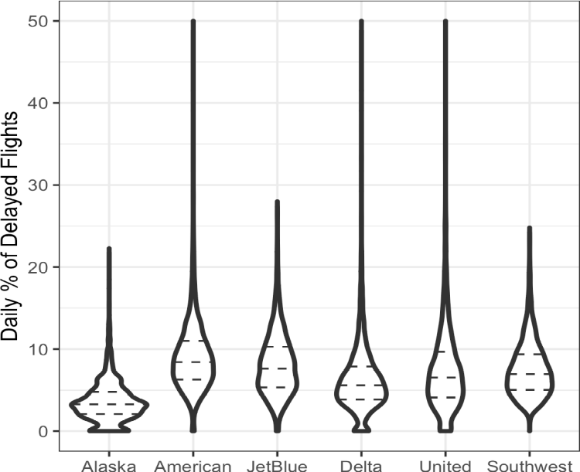
A violin plot, introduced by [Hintze-Nelson-1998], is an enhancement to the boxplot and plots the density estimate with the density on the y-axis. The density is mirrored and flipped over, and the resulting shape is filled in, creating an image resembling a violin. The advantage of a violin plot is that it can show nuances in the distribution that aren’t perceptible in a boxplot. On the other hand, the boxplot more clearly shows the outliers in the data. In ggplot2, the function geom_violin can be used to create a violin plot as follows:The violin plot shows a concentration in the distribution near zero for Alaska and, to a lesser extent, Delta. This phenomenon is not as obvious in the boxplot. You can combine a violin plot with a boxplot by adding geom_boxplot to the plot (although this works best when colorsare used).
Figure 1-11. Violin plot of percent of airline delays by carrier
Violin plots are available with the violinplot method of the seaborn package:
ax = sns.violinplot(airline_stats.airline, airline_stats.pct_carrier_delay,=inner='quartile', color='white')
ax.set_xlabel('')
ax.set_ylabel('Daily % of Delayed Flights')

Slide 36
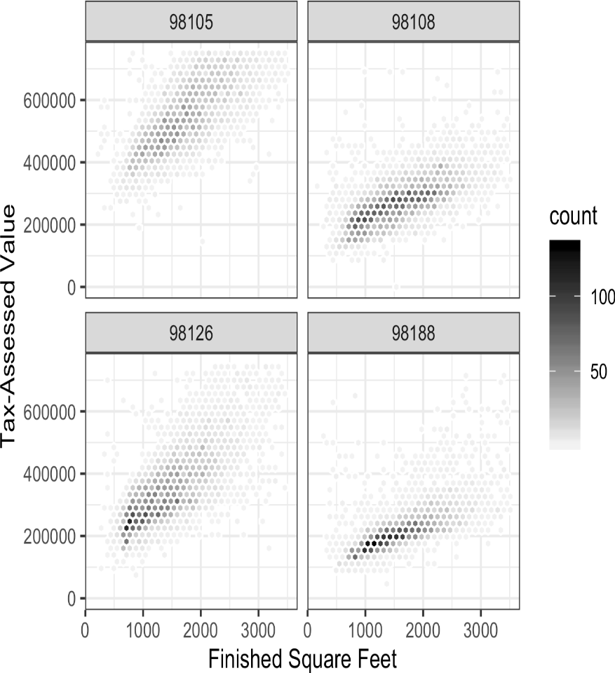
Visualizing Multiple Variables
The types of charts used to compare two variables—scatterplots, hexagonal binning,and boxplots—are readily extended to more variables through the notion of conditioning.
As an example, look back at Figure 1-8, which showed the relationship between homes’ finished square feet and their tax-assessed values. We observed that there appears to be a cluster of homes that have higher tax-assessed value per square foot. Diving deeper, Figure 1-12 accounts for the effect of location by plotting the data for a set of zip codes. Now the picture is much clearer: tax-assessed value is much higher in some zip codes (98105, 98126) than in others (98108, 98188). This disparity gives rise to the clusters observed
Figure 1-12. Tax-assessed value versus finished square feet by zip code

Slide 37
Python code: Fortunately, seaborn has a relatively straightforward way of creating Visualizing Multiple Variables graphs:
zip_codes = [98188, 98105, 98108, 98126]
kc_tax_zip = kc_tax0.loc[kc_tax0.ZipCode.isin(zip_codes),:]
kc_tax_zip
def hexbin(x, y, color, **kwargs):
cmap = sns.light_palette(color, as_cmap=True)
plt.hexbin(x, y, gridsize=25, cmap=cmap, **kwargs)
g = sns.FacetGrid(kc_tax_zip, col='ZipCode', col_wrap=2)
g.map(hexbin, 'SqFtTotLiving', 'TaxAssessedValue',extent=[0, 3500, 0, 700000])
g.set_axis_labels('Finished Square Feet', 'Tax-Assessed Value')
g.set_titles('Zip code {col_name:.0f}')

